Slide 1
Stepwise Process for Improving the Quality of Rapid and Recency Testing (SPI-RRT)
A Training Program on Auditing HIV Rapid and Recency Testing Sites Toward Certification
Notes:
So let’s start with a bit of background on HIV testing, the gaps observed under the HIV program which will help to give some context on how the SPI-RRT checklist plays a role in quality.

Slide 2
HIV Testing Services Offered in PEPFAR-Supported Countries (2004-2018)
Notes:
As you can see here HIV testing services scaled-up drastically from 1.9 million people offered services to 95 million in 2018. With this type of scale-up and in the era of test and start, the quality of HIV rapid testing becomes all the more critical to ensure the accuracy and reliability of the results.

Slide 3




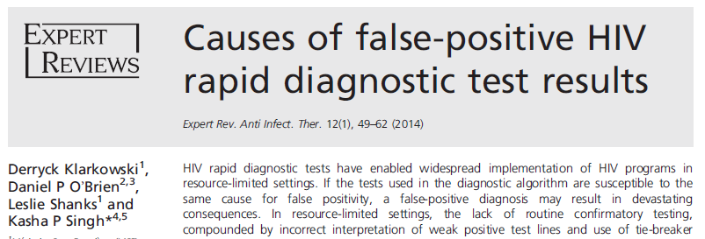


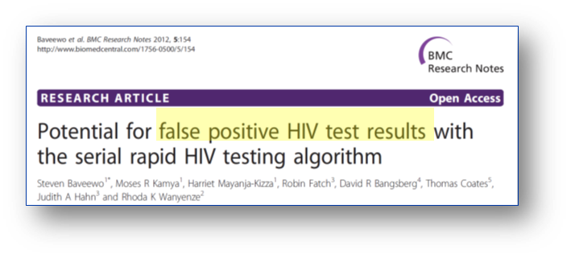
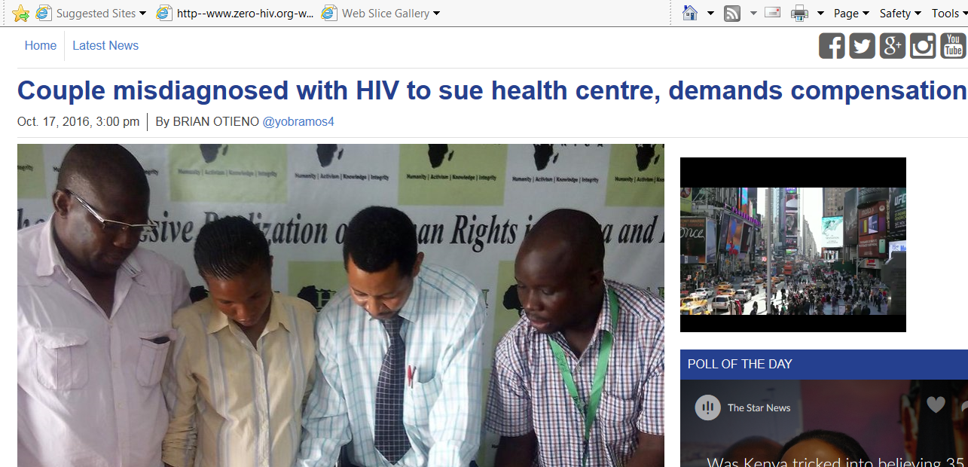
Key Issues: Accuracy of HIV Tests in the Era of Test and Start
Notes:
One of the key issues that has been observed under the HIV program is misdiagnosis of a clients HIV status. Where a person has been given a false positive or false negative diagnosis. What is the impact of a false positive or false neg diagnosis? These are just a few articles highlighting this issue.

Slide 4
Realities of HIV Testing under Program Conditions
Poor training and training often done by lay counsellor
Testing algorithm and procedures not followed
Disorganized workspace
Run-time not followed, no timers
Safety concerns
Poor finger-prick procedure
PT program inconsistent
Little or no supervision
No corrective actions/feedback
Notes:
This is the reason that the rapid testing continuous quality improvement initiative was developed.

Slide 5
Rapid Testing Continuous Quality Improvement (RT-CQI) Initiative
Comprehensive package of quality assurance activities
Intended to build upon existing quality improvement programs
Data driven by innovative approaches to achieve better uptake, coverage, and impact
Aim at reducing HIV testing errors to ensure efficient service delivery
Five priority areas
Support for policy on quality of HIV testing
Scale up of proficiency testing
Increase uptake of standardized HIV register
Strengthen capacity for new kit lot verification
Support for certification of HIV test providers and sites
Continuous Quality Improvement for HIV Rapid and Recency Testing (RRT-CQI)
Notes:
Policy Engagement - Engage stakeholders & advocate for resource allocation, Invest in quality systems
Increasing coverage of Proficiency Testing – we want to make sure all sites and/or testers that offer HIV rapid testing are participating in a PT program, data is analyzed and feedback is provided in a timely fashion so corrective action can be implemented and sites and/or testers improve
Scaling up Standardized HIV Testing Register - Increase uptake of standardized HIV testing register, collect and analyze data from the HTS register for real-time monitoring and corrective actions
Establishing a certification program - Develop a competency-based training program to certify testers, Monitor quality compliance at testing sites for certification
Now with the implementation of the HIV-1 recent infection surveillance in countries using the rapid test for recent infection it is important to integrate these CQI concepts with RTRI.

Slide 6
Quality Assurance Cycle
QAC
(RTRI Implementation)
Plan
Collect data
Monitor
Corrective Actions
Review & Analyze data
Improve
Develop
Implement
Train testers
Training tools
Data capture tools
On-site Refresher
Provide feedback
Notes:
To ensure quality testing, reporting, pre- and post-testing counseling a quality management system should be implemented. The diagram above shows the steps of quality assurance that should occur in a continuous cycle to implement the quality management system:
Plan/Develop - Planning through engaging leadership, establishing a national QA coordination team, in the develop phase defining roles and responsibilities of key partners involved, reviewing and developing QA tools such as training and data capture tools
Implementation is done through training and certification of test providers, site accreditation, supportive supervision, adequate quality and process control, documentation and ensuring a robust supply chain.
Monitoring phase – reviewing and analyzing the data from these QA activities
Corrective actions – providing timely feedback to sites and implementing corrective actions such as on-site refresher trainings
The end goal is to show Improvement and using data for decision-making, undertaking advocacy and communication, and increasing ownership

Slide 7
A Complete QA Cycle for Site AUDIT
QAC
(SPI-RRT)
Implement
Monitor
Evaluate
Define
Improve
Plan
Training
Audits
Collect data
Review
Analyze data
Requirements
Audit roles
Corrective Action
Certify
Ensures that correct test results are provided to client
Provides means to prevent, detect and correct errors
Reduces costs
Document
processes
Notes:
To ensure quality testing, reporting, pre- and post-testing counseling a quality management system should be implemented. The diagram above shows the steps of quality assurance that should occur in a continuous cycle to implement the quality management system:
Plan/Develop - Planning through engaging leadership, establishing a national QA coordination team, in the develop phase defining roles and responsibilities of key partners involved, reviewing and developing QA tools such as training and data capture tools
Implementation is done through training and certification of test providers, site accreditation, supportive supervision, adequate quality and process control, documentation and ensuring a robust supply chain.
Monitoring phase – reviewing and analyzing the data from these QA activities
Corrective actions – providing timely feedback to sites and implementing corrective actions such as on-site refresher trainings
The end goal is to show Improvement and using data for decision-making, undertaking advocacy and communication, and increasing ownership

Slide 8

Quality Assurance Cycle Roadmap
Training of Auditors
Training of Auditors
Improvement Plan
Site Certification
Baseline Audit
Follow up Audits
Overall Improvement

Slide 9
Training Approach

Slide 10
Training Approach
Purpose
Strengthen QMS
Emphasis on action and measurable improvement
Target Audience
National HIV/AIDS program
RT/RTRI Master trainers
RTCQI Quality Mentors
QA officers (site and district)
Laboratory Professionals (site and district)
Length
Training Content
Ensure the QAC is complete at site level
Support CQI at HIV RT/RTRI testing sites toward certification
Local Implementing Partners
Recency Coordinators
SLMTA Mentors
SLIPTA assessors
Five - Six days
Review of QA practices and national guidelines
Introduction to Site Audits
Includes Site Audit practical
Introduction to Audit Tool (SPI-RRT)
Review of e-tool (ODK) to collect audit data
Assessing Competency –Site Audit Practical
Standard training package

Slide 11
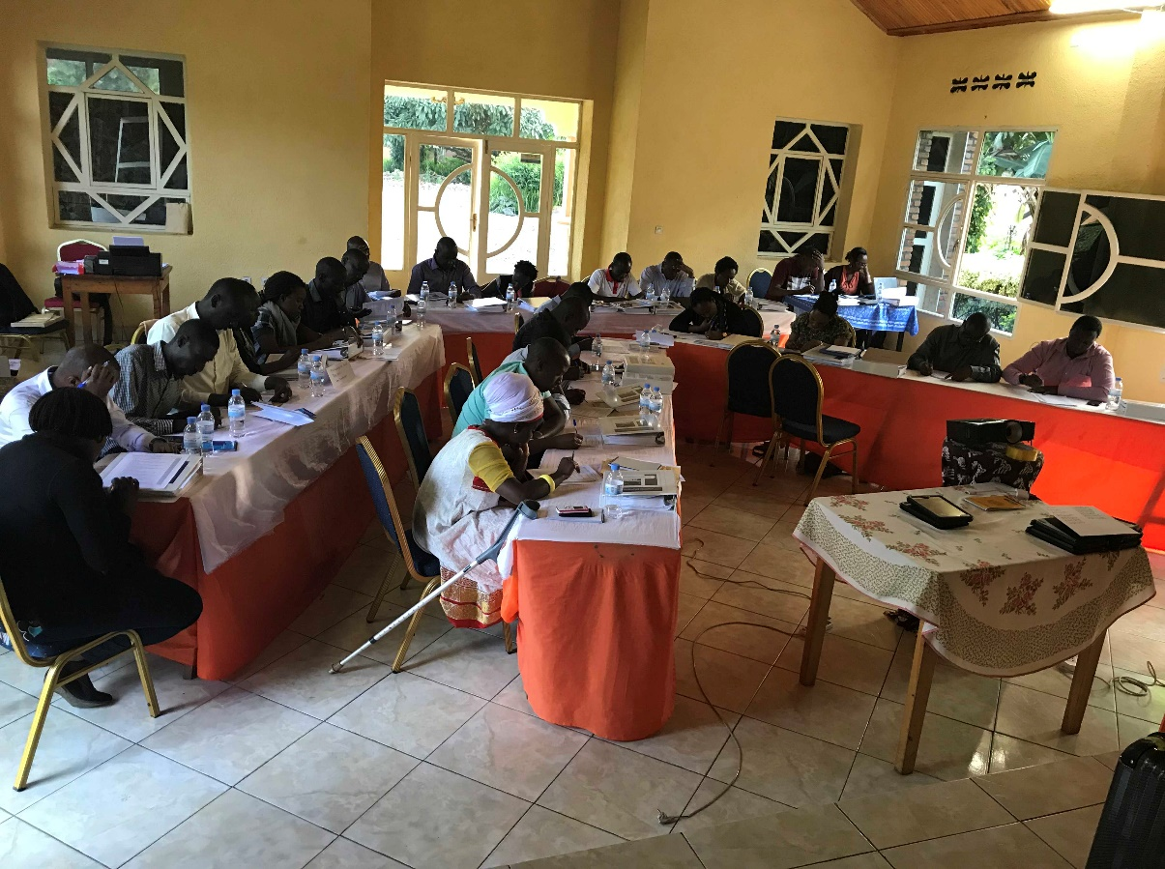
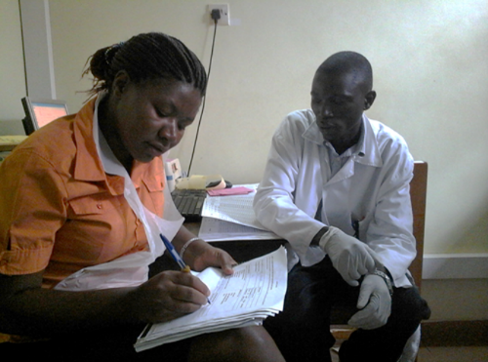
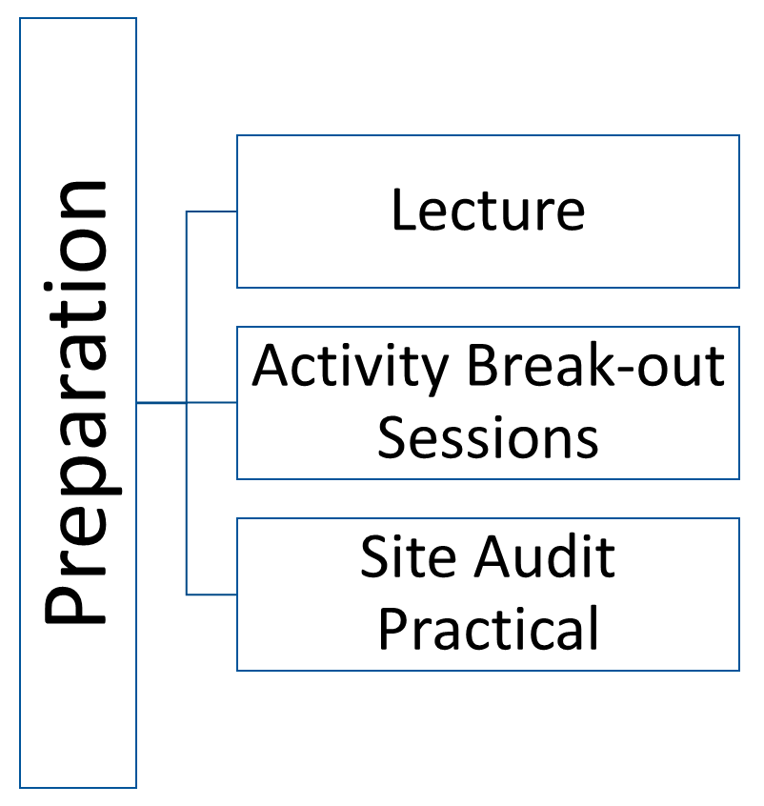
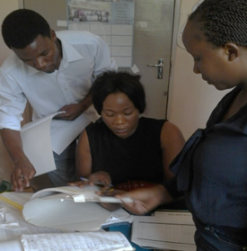
Training Structure

Slide 12
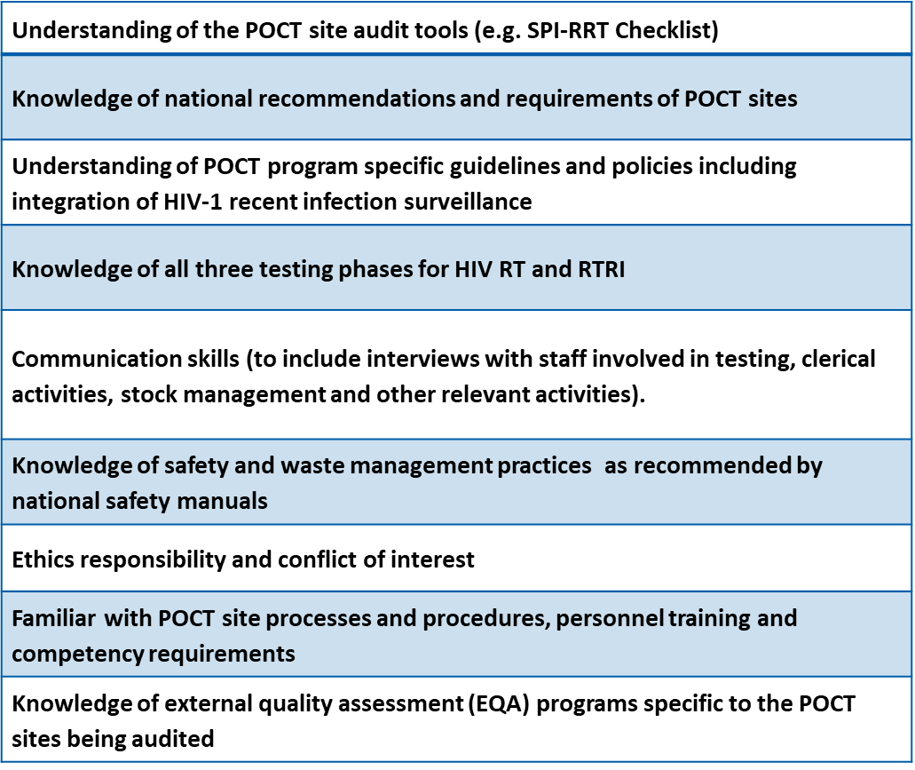
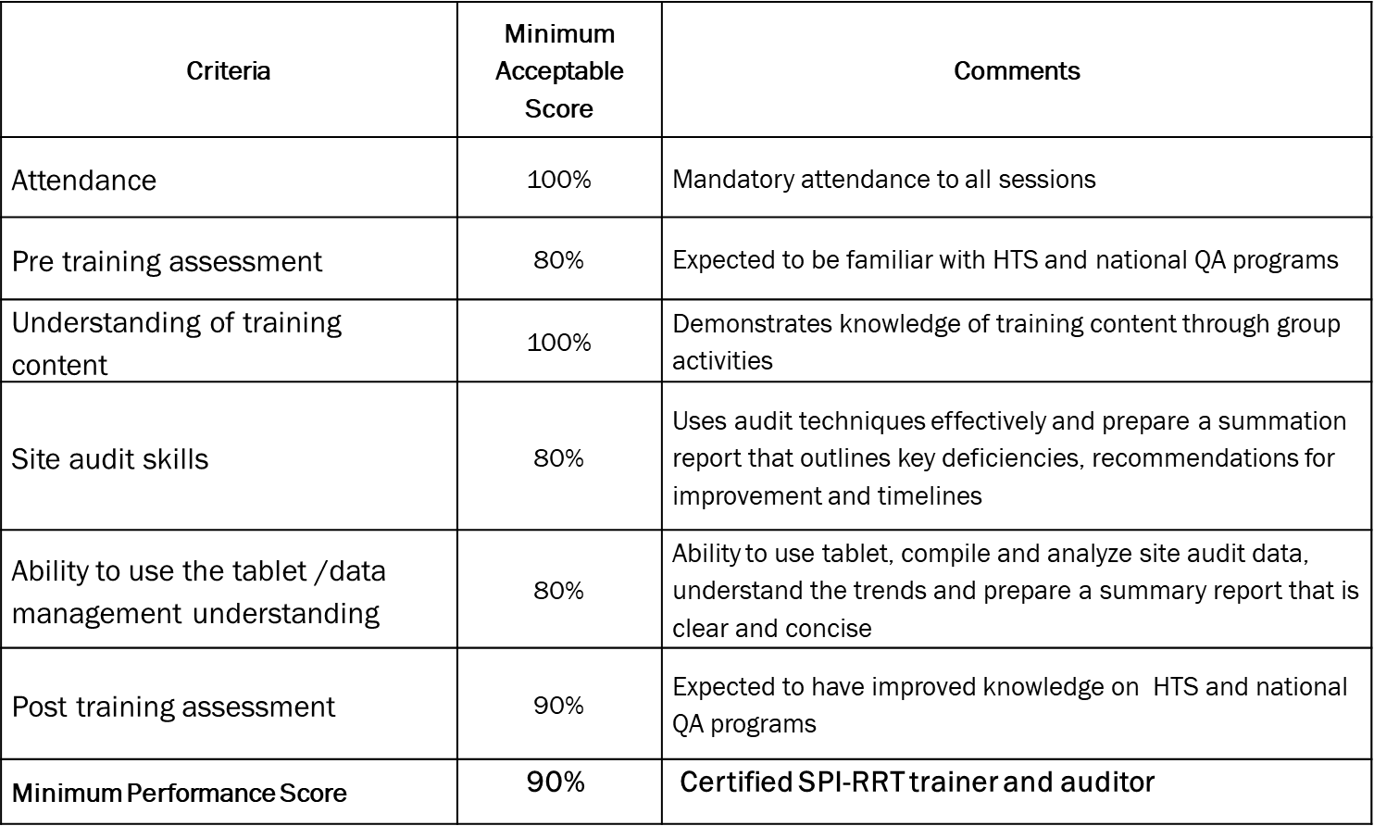
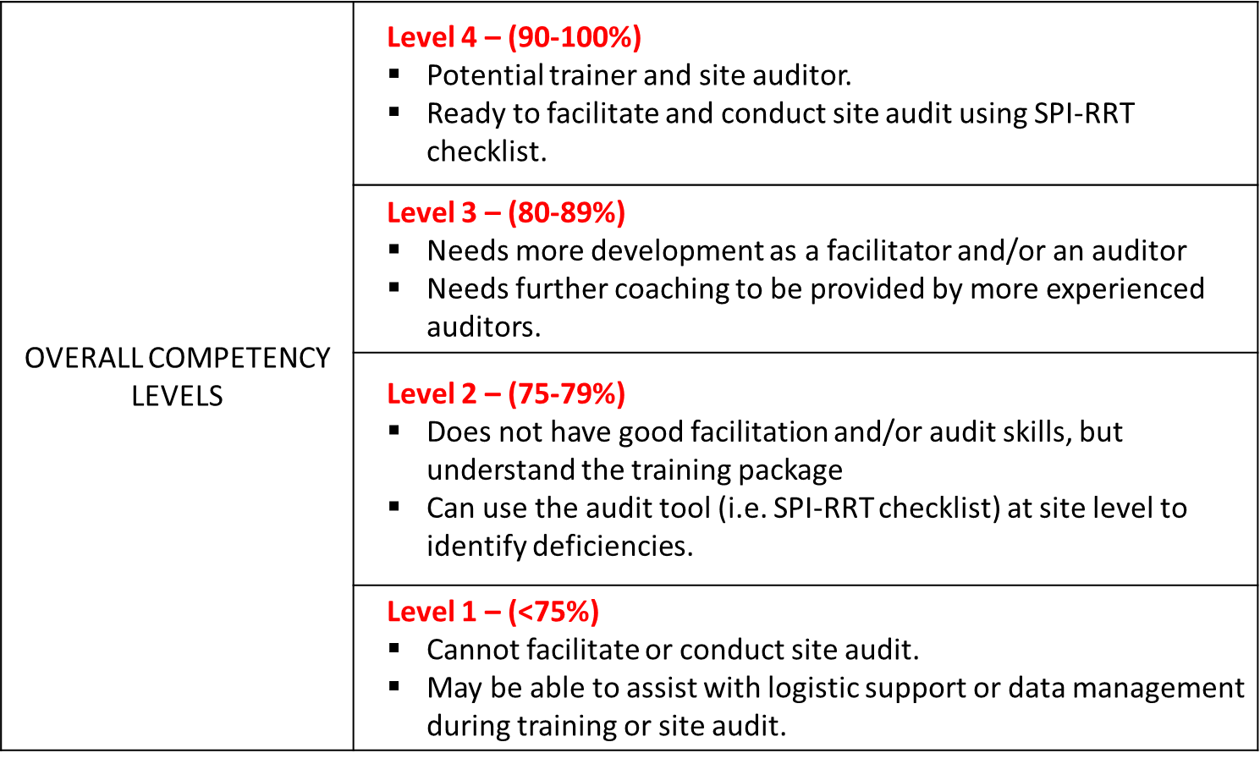
Criteria for Site Auditors

Slide 13
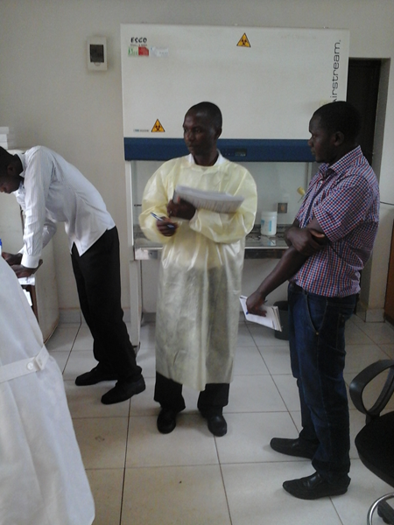
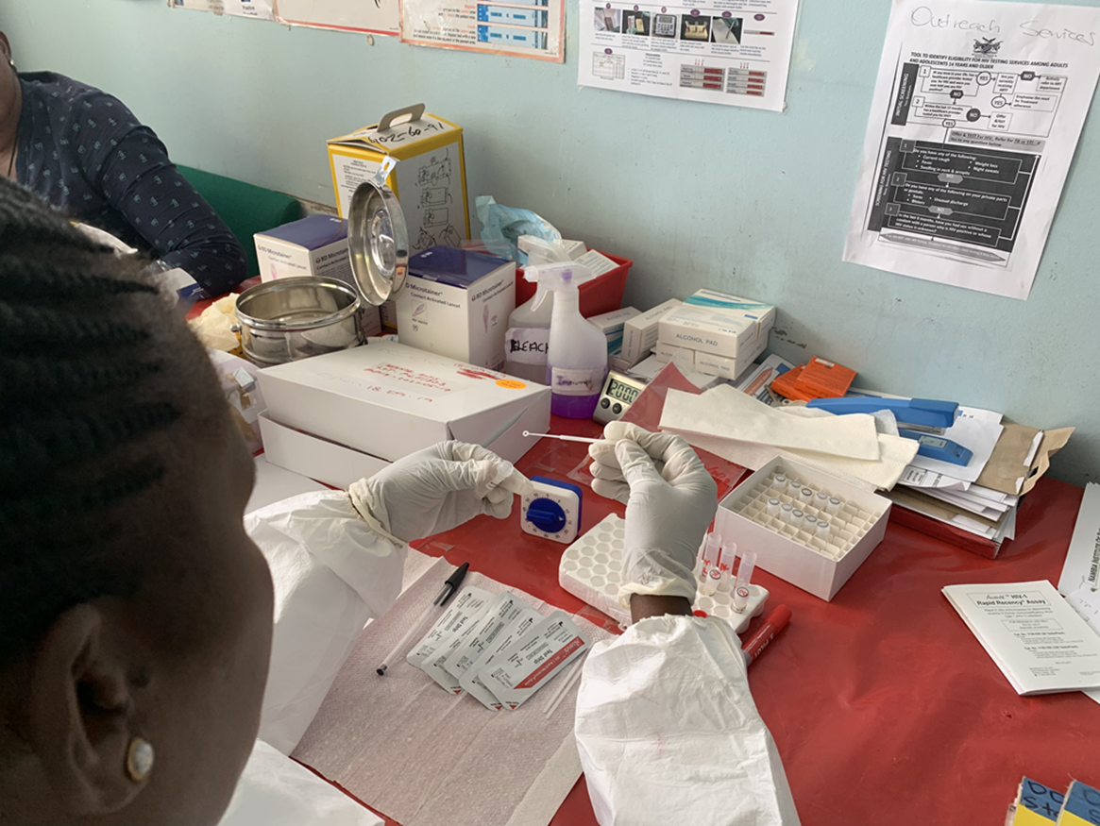
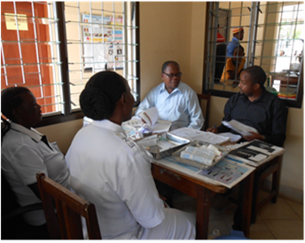
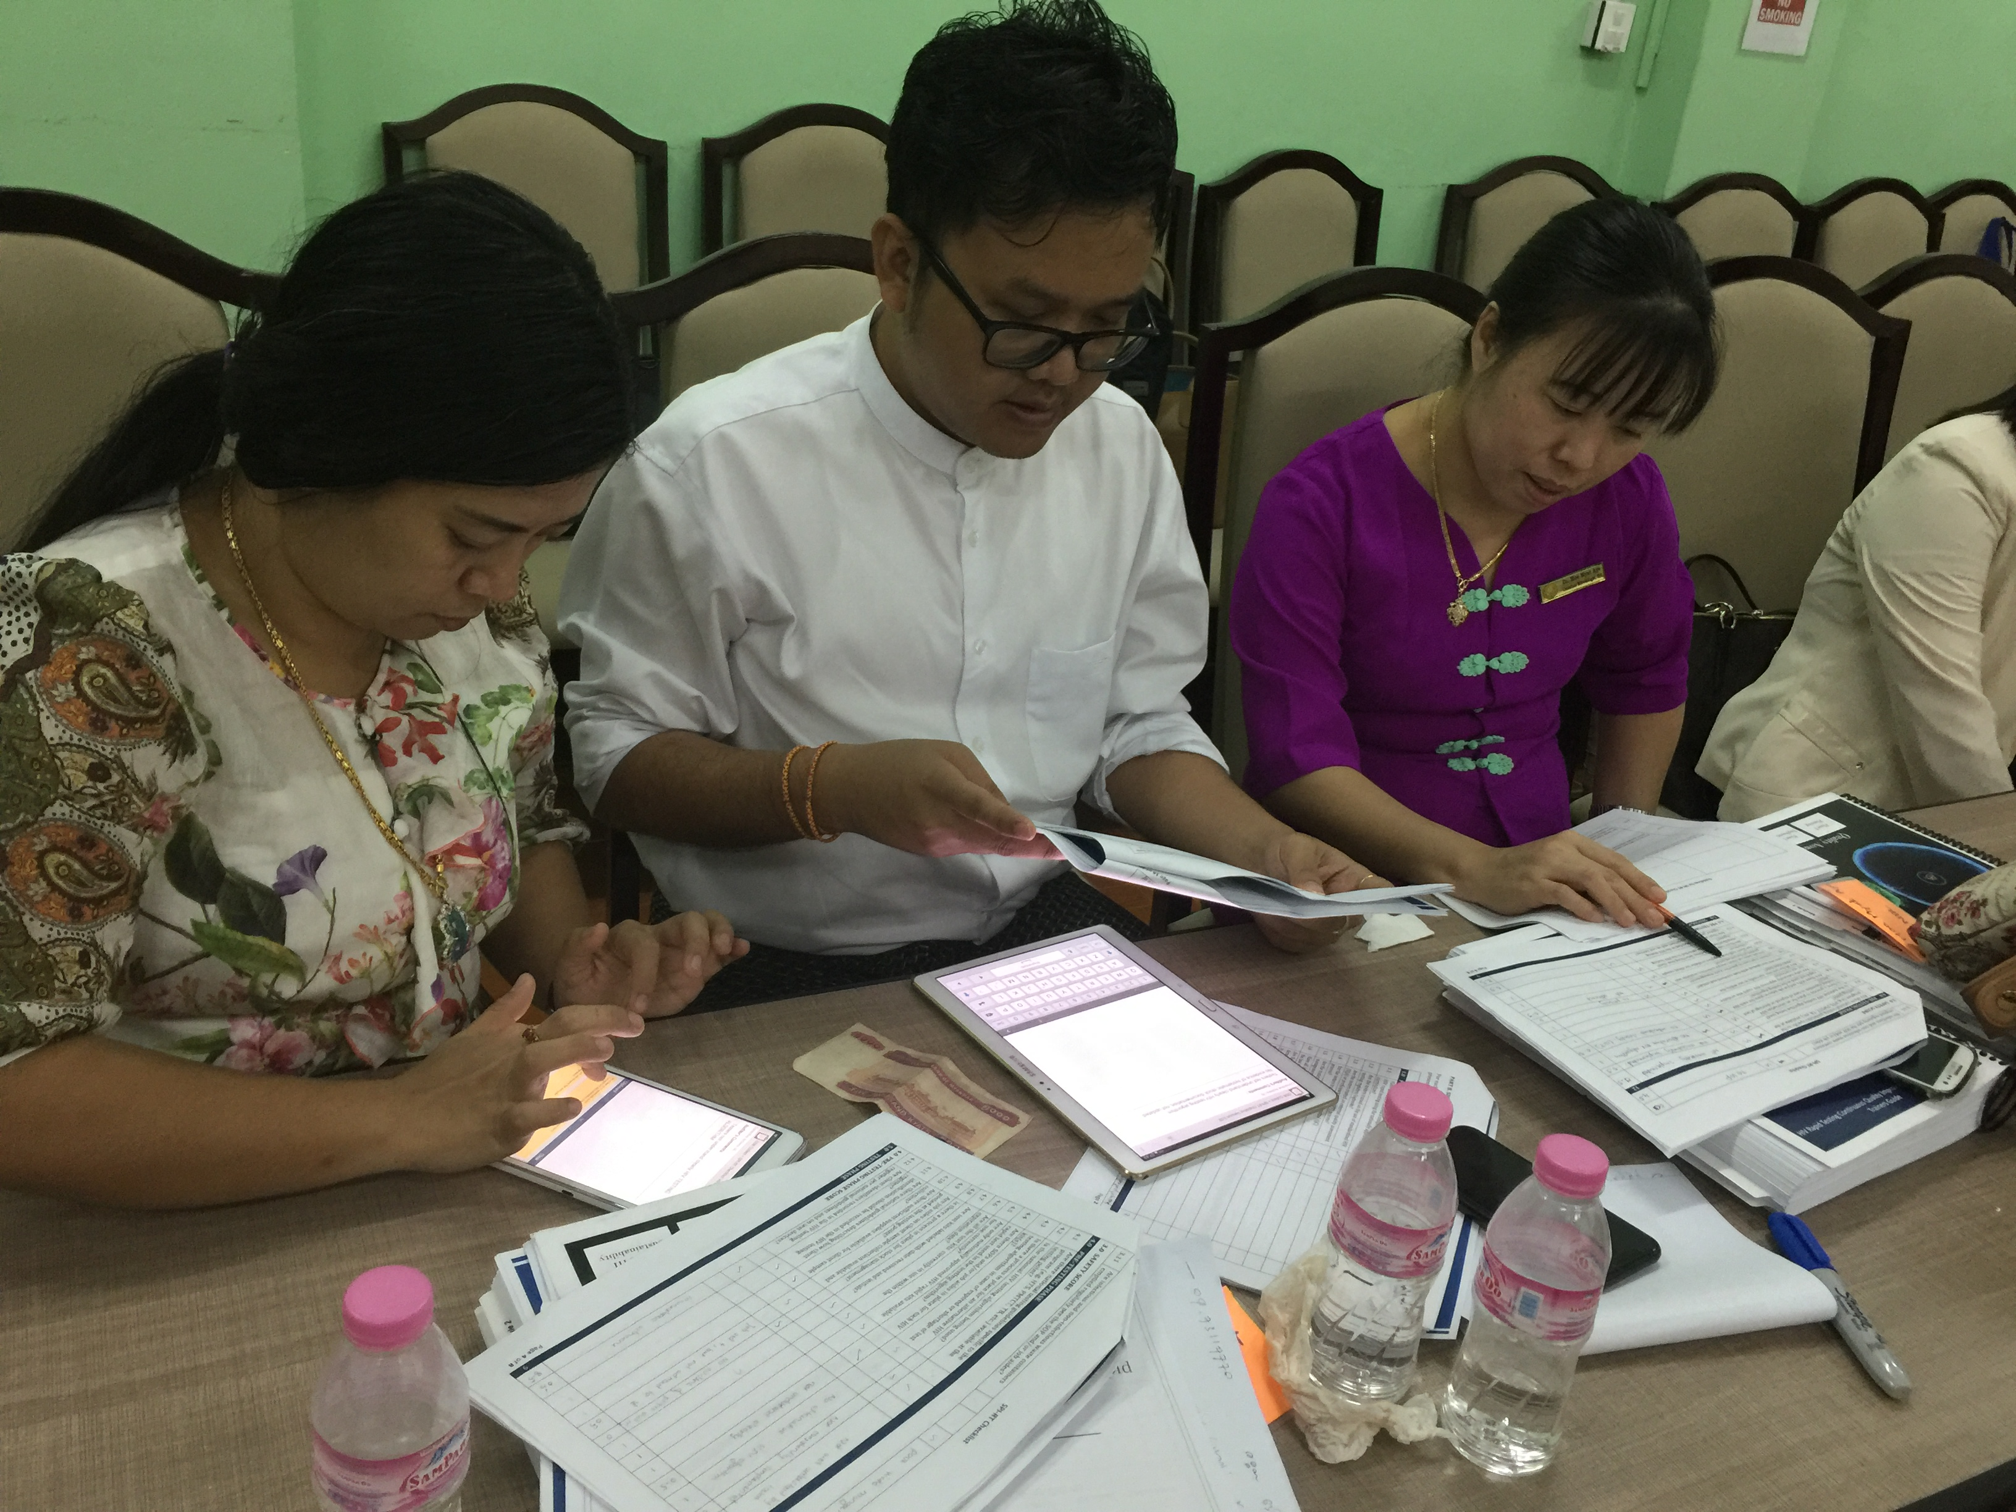
Site Audit Practical
Dissemination of findings
Observe site operations
Direct Observation of Testing
Compiling audit responses and summary of corrective actions into ODK tablet application

Slide 14



Impact of COVID-19
Classroom Didactic Sessions
Site Audit Practicals
Virtual Training
LaTasha Williams, MPH CDC-HQ
Notes:
Because of the impact of COVID-19 we have to change the way we do trainings. As some of you have seen LaTasha wonderful presentation on virtual training in the era of COVID, we now have to shift from the traditional classroom did. Sessions and site audit practicals to virtual training approach.

Slide 15
Virtual Training Approach
Session Type | Approach
Webinar | Presenter speaks live via Microsoft Teams.
Live Demonstration | Presenter demonstrates live with shared screen via Microsoft Teams.
Google Classroom | Private work through your Google Classroom. To be completed between scheduled sessions.
Guided Discussion/ Interactive | Facilitator guides discussion via Microsoft Teams, sharing necessary content throughout. Attendees use the “Raise hand” function and unmute to participate Attendees can also share questions or comments through the chat.
Short Breaks | Short 10-minute breaks between sessions.
Notes:
If this method is successful, then we will use this approach for future trainings

Slide 16
Agenda (1)
Start Time | Day 1 – December 14th | Facilitator
8:00 | Introduction to SPI-RRT training Group Introductions Training Overview and Learning objectives Review training agenda | Keisha Jackson
9:00 | Module 1.0 Quality Assurance for HIV Rapid and Recency Testing | Keisha Jackson
10:30 | Module 2.1 Introduction to Site Audits | LaTasha Williams
11:00 | Module 2.2 Auditors Professional Ethics | LaTasha Williams
12:00 | Assignment from Module 1: Review SPI-RRT checklist and Users’ Guide | Keisha Jackson
12:15 | END OF DAY 1
Start Time | Day 2 – December 15th | Facilitator
8:00 | Module 3.0 Introduction to SPI-RRT checklist Sections 1-7 HIV Rapid Testing | Keisha Jackson
9:30 | Module 3.0 Introduction to SPI-RRT checklist Sections 8 HIV-1 Recent Infection Surveillance Section S.0 HIV-1 Recent Infection Surveillance Study Protocol Section D.0 HIV-1 Recent Infection Surveillance Using Data Indicators
11:00 | Module 3.0 Introduction to SPI-RRT Checklist - Q&A Session | All
12:00 | Assignment from Module 3.0: Identify issues and Provide corrective actions Completing the Summation Report Scenarios | Amy Zheng
12:15 | END OF DAY 2

Slide 17
Agenda (2)
Start Time | Day 3 – December 16th | Facilitator
8:00 | Review of Module 3.0 Assignments | Keisha Jackson
10:00 | Module 4.0 Introduction to Site Audit Collection Tool - Tablet application (ODK collect) | Keisha Jackson
10:30 | Module 5.0 Site Audit Data Analysis | Keisha Jackson
11:30 | Assignment from Module 5.0 Analysis of site audit data | Amy Zheng
11:45 | END OF DAY 3
Start Time | Day 4 – December 17th | Facilitator
8:00 | Review of Module 5 Assignment – presentation of data analysis by participants | All Participants
10:30 | Final Q&A Session and Next Steps | All Participants
11:30 | END OF DAY 4

Slide 18
Google Classroom
You will find all the materials you need for each session under Classwork and the Session Number.
Each day, homework assignments will be released into your Classwork as Google Forms for you to complete before the next session.
Recordings of the presentations and sessions will be available for you to view anytime after the workshop through the Classwork and Session Number.

Slide 19
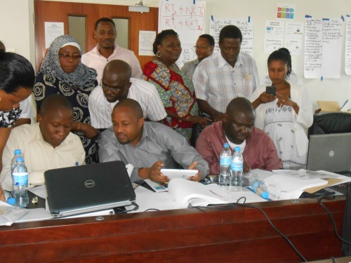
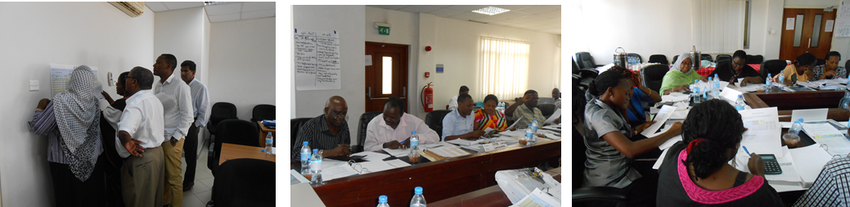
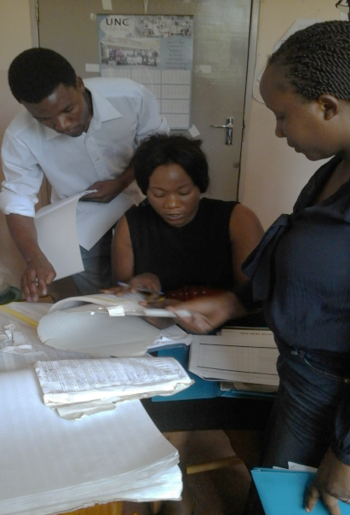
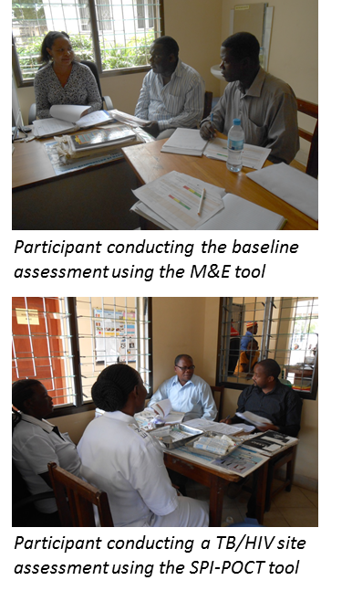
Training Expectations
Clear understanding of training content
Participant competent to deliver training package
Participants competent to conduct site audits and provide corrective actions
Participant understands how to summarize and disseminate audit findings

Slide 20
Housekeeping rules
 | Facilitators | Participants
Be on time |  | 
Preparation |  | 
Cell phone | Mute or turn off | Mute or turn off
Respect | Manage respectfully challenging participants | Respect others opinion
Interaction | Engage participants | Actively participate Ask questions
Feedback | Provide constructive feedback | Be opened to feedback

Slide 21
Questions?

